Slide 1

Flash Review
Notes:
Objective
Find new ideas to reduce time and/or perceived time in our applications by 30%.

Slide 2


Agenda
Innovation Contest
Ideas: Flash Review – 3 min / team!
Let’s go for speed!

Slide 3

Innovation Contest – Where are we?
Idea selection
Ideation Sessions
Submit an idea!
Build a team
Make it real!
Notes:
Many ideas (500 views by 150 people) have been suggested! 29.
Lots of outcome during the 4 ideation sessoins (2 in BLR and 2 in NCE)
Among all the them the focus is now on 5 of them.
Purpose of this meeting is to review them quickly: in 3 min. Team, Problem fixed, Idea and Deliveries

Slide 4
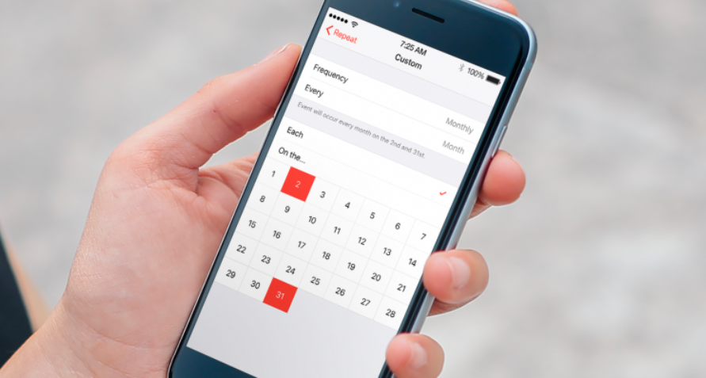
Link my Travel

Slide 5
Link my travel
The team
Muthukumar CHINNU
Abhishek BURAGOHAIN
Severine PERCHERON
Maeva CECCHI
Rakesh MEMBARAM
Deliveries
Business Highlight
Mockup
Solution & PoC on RefX in iOS

Slide 6




Link My Travel
Problem & Solution ideas
Creating a booking can be perceived as long and cumbersome, especially for regular travelers
Need to go through the same steps and enter the same information
May miss some professional or personal constraints
-> leading to a waste of time
Link My Trip to my bookings and searches
Propose a list of trip options based on a combination of bookings history: O&D, day of the week, time, and recent searches on Mobile
-> accelerate the booking creation
-> optimize passenger information accuracy
Link My Trip to my agendas
Propose the right booking options, based on agendas: relevant passenger information should be prefilled, and relevant flight solutions should be displayed in line with agendas
-> accelerate the booking process
-> reduce the risk of ticket change due to some omitted events
Notes:
For non regular travelers it can be stressful as the complexity is error prone (error in the name..).. For these 2 types of population there is a need for support when completing the booking.
This will accelerate the booking creation and at the same time optimize passenger information accuracy.
Let's take, for example a regular traveller, who works in PAR during the week, and need to go home in NCE for the week-end:
The system should directly propose his favorite flight, according to his flight history for the friday evenin
Agenda as an input:On a particular Monday and for the whole week, the traveler has to attend a workshop in London-> The system should display a warning on a mismatch with calendar and then propose him the right flights combination: NCE-PAR-LON-NCE
If the traveler has a personal event up to 7PM on Sunday, the system should remind him that the usual flight at 6PM does not match his constraints, and then propose him relevant alternatives

Slide 7
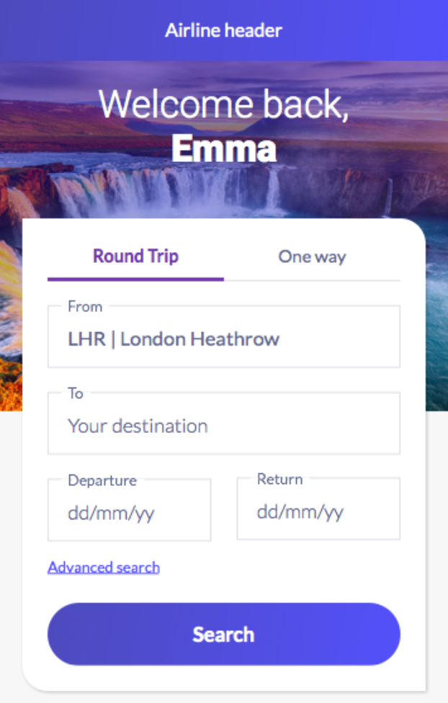
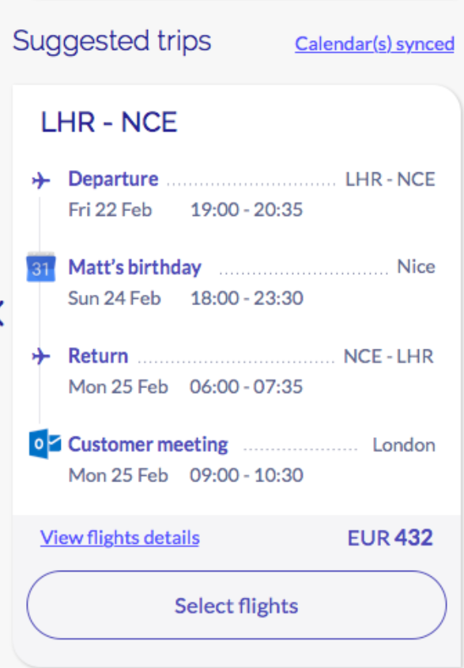
Mockup: Link My Travel to my agendas

Slide 8
Link My Travel
iOS – JS bridge
iOS
RefX
Booking
History
Search
Suggested
Trips
Availability
Pax
Payment
Confirmation
Advanced
Search
Offer 1
Offer 2
Offer n
Read Travel History
Fetch meeting and appointment
Redux Store
Calendar
Search History
Booking History

Slide 9

Tailor your flow

Slide 10
Tailor My Trip
Increasing Revenue through increased Customer Satisfaction
Stephen Ford
PM for the Digital Experience Suite
Reference Experience
Notes:
Cover example with no photo
To update the text, just click on the text
To get more slides with this layout just copy this slide and paste

Slide 11
Tailor your flow
Team: TBD
Problem: Length of flow causing abandonment, user frustration and lack of site loyalty
Idea: Allow user to drive their experience to meet their needs
Delivery: Tentative delivery after PI7 IP Sprint

Slide 12
Landing Page or During Load of Availability
How it works:
Options on the landing page or via a popup after entering the flow:
Flights Only (Read Only not optional)
Choose my seat (still displayed if seats are free optional)
Select my Meal
Additional Luggage (could be left off the list and still kept in all flows)
Other extras (Car Rental, Hotel, Lounge…)
Show me everything
* If the airline wished as part of the Itinerary Recap right before or on payment, the catalog could still be presented as a passive teaser while the ones that the user selected are set to default “Open” with the appearance of being a standalone page.
Notes:
Please read these useful tips before you start using this template
Remove this slide when your PPT is ready

Slide 13
Approach
Option 1 UX Approach
UX Design during PI7
Clickable Prototype PI7 IP Sprint
User testing
Since this is based on a clickable prototype, KPIs will not be measured by real performance.
Development when feasible in the Blue Train (if accepted)
Option 2 Development Directly
High level UX design delivery
Allocate a resources during PI7 IP Sprint
Build the component and logic.
NOTE: PI7 Ancillaries is still minimal, would most likely need some dummy components added for testing the value proposition

Slide 14
The Booking Flow
And Site Navigation
Airline Portal: Flights Only
Confirmation Page
Shopping 1
Traveler Page
Terminal info
Shopping 2
Payment
Itinerary Recap/Shopping Cart
Shopping Cart
Legend
Standard flow
Airline side
1A solution or external
Optional in the flow

Slide 15
The Booking Flow
And Site Navigation
Airline Portal: Flights and Seats selected
Confirmation Page
Traveler Page
Seats Page
Shopping 1
Ancillary Step
Terminal info
Shopping 2
Payment
Itinerary Recap/Shopping Cart
Shopping Cart
Legend
Standard flow
Airline side
1A solution or external
Optional in the flow

Slide 16
The Booking Flow
And Site Navigation
Airline Portal: Show all (as catalog)
Confirmation Page
Traveler Page
Catalog Page
Shopping 1
Ancillary Step
Terminal info
Shopping 2
Payment
Itinerary Recap/Shopping Cart
Shopping Cart
Legend
Standard flow
Airline side
1A solution or external
Optional in the flow

Slide 17

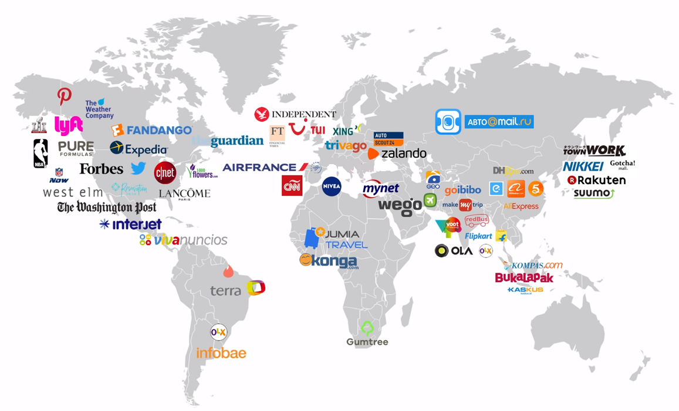
Progressive Web App
Shrey RUPANI & Julien ARAMINO
With Jean MOUYADE support

Slide 18
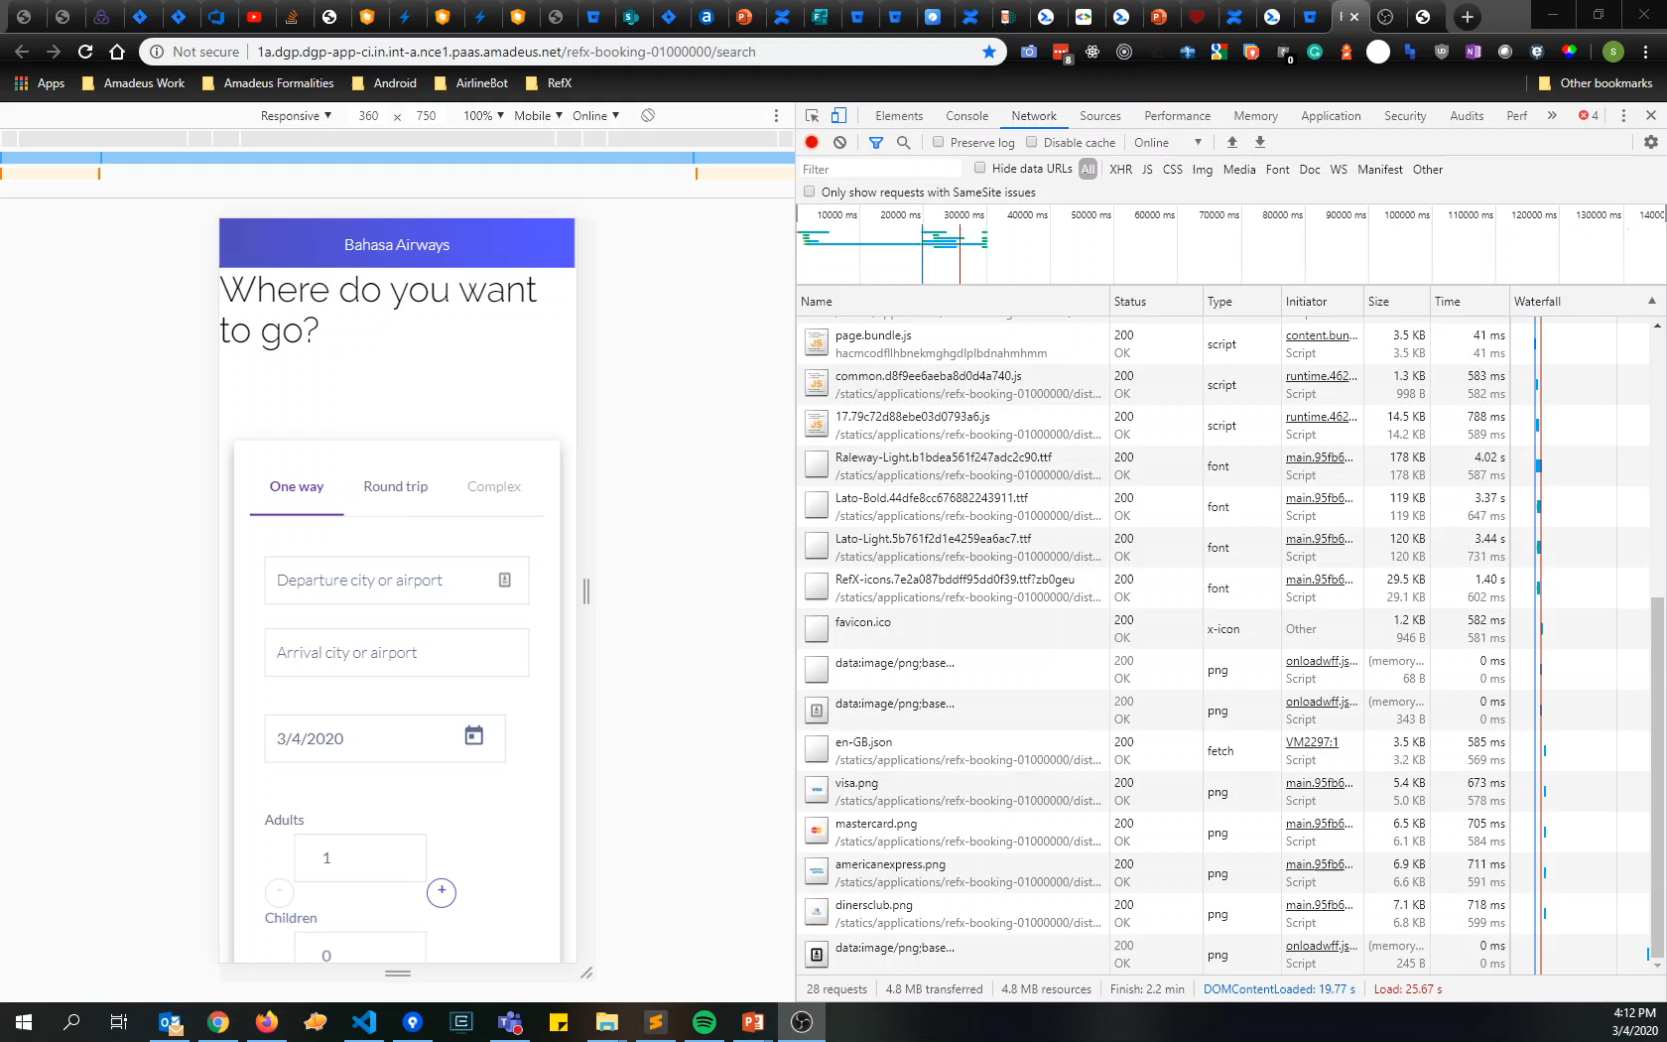
The problem
Is it worth installing the app?
Notes:
When customers want to access airline services, they are given the choice between the web and the app.
And they are going to go one way or the other depending on criteria.
Web apps have reach, but native apps have capabilities such as...

Slide 19
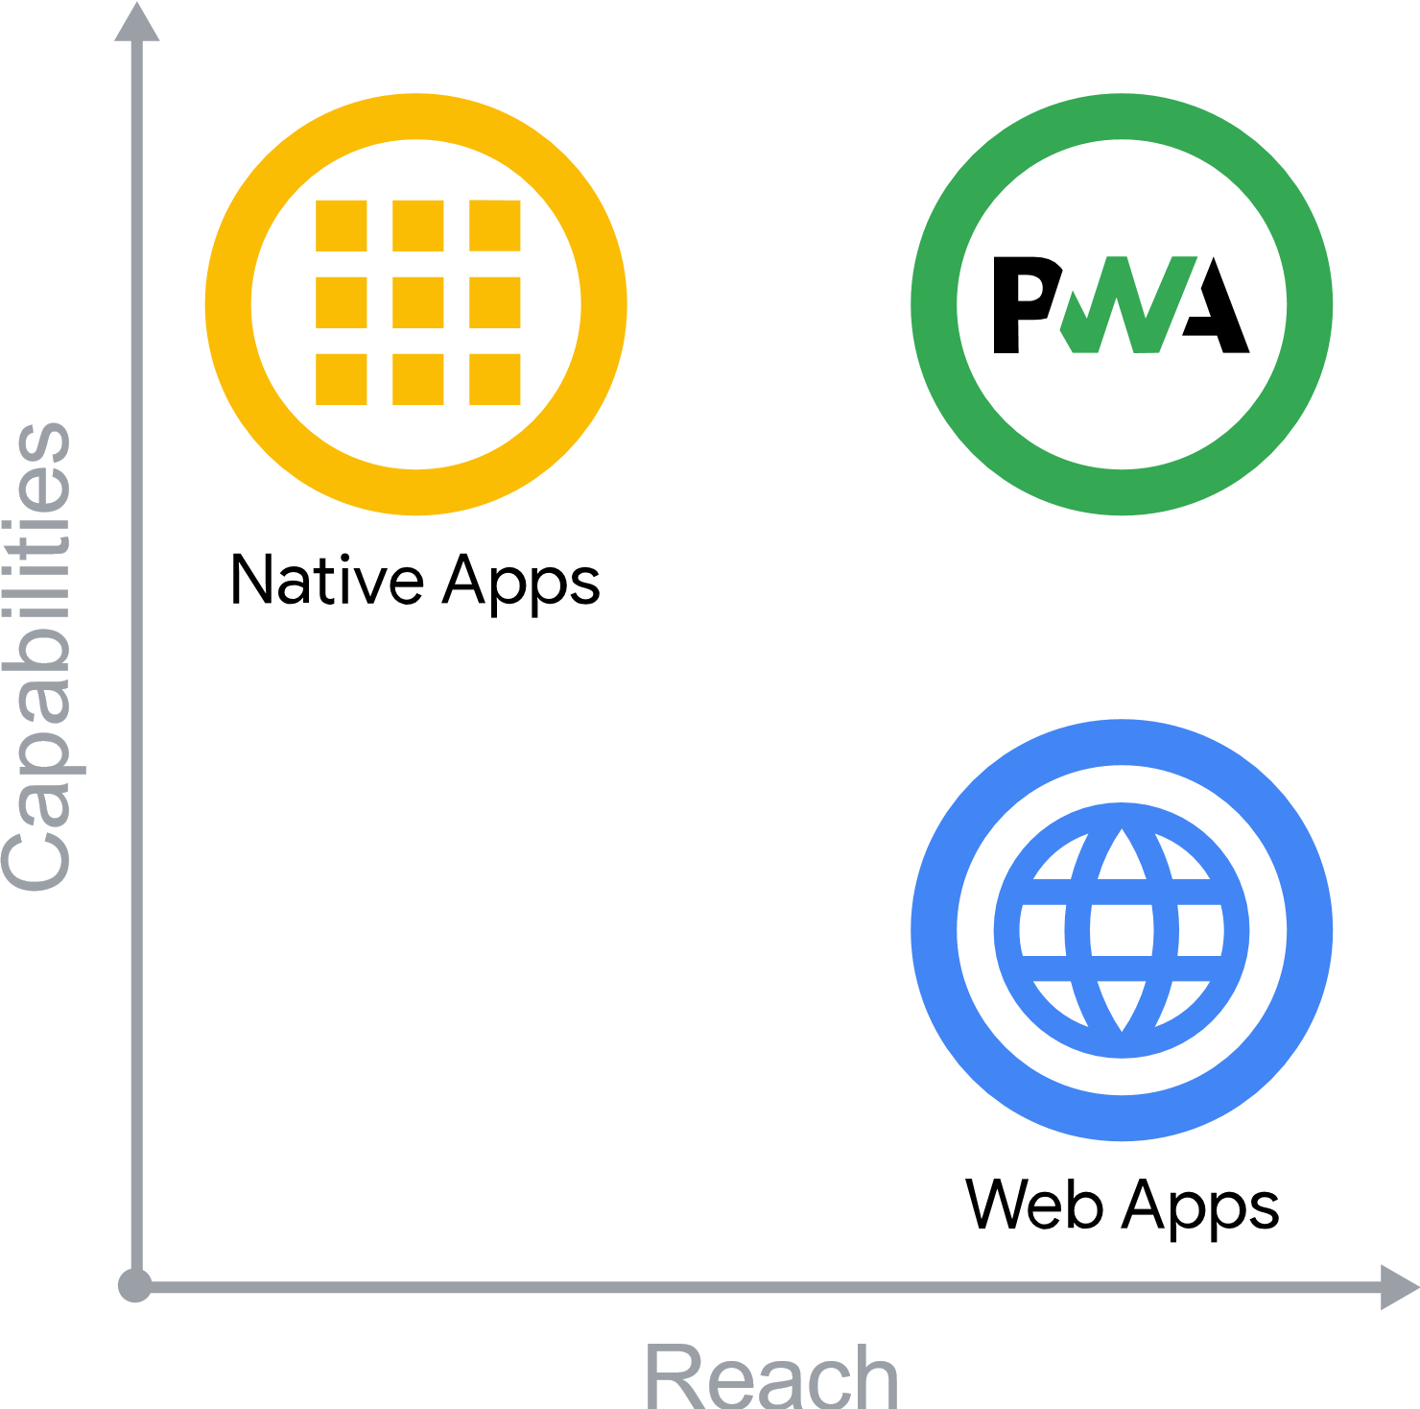
Idea
Highly performant Reference Experience
Skip app store step to install airline app
Evergreen app and web
Offline support
Single code base
Standalone experience
Notes:
Progressive Web Apps (PWA) are built and enhanced with modern APIs to deliver native-like capabilities, reliability, and installability while reaching anyone, anywhere, on any device with a single codebase.

Slide 20
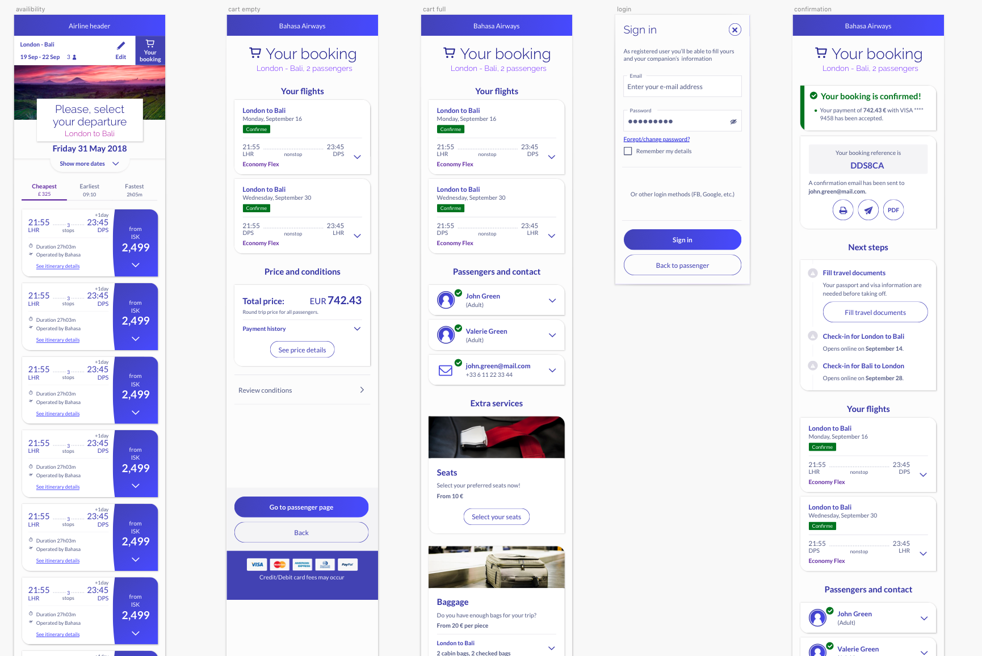
When user is engaged?
UX Study
When to prompt for installation?
After search ?
On cart
Before sign in
On confirmation
How to prompt?
Banner
Card
Bottom sheet
Button in header
…

Slide 21
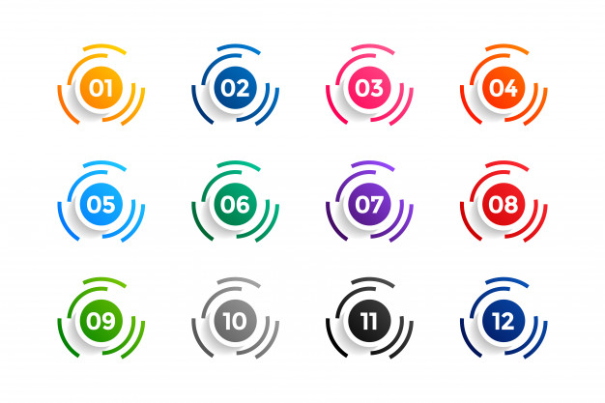
Delivery
Installable PWA with prompt
Statics loaded by service worker
Splash screen
Determine perceived user response time
Notes:
I think the committed scope is to:
Create a manifest file for bookmark
Splash screen
Start using the service worker to fetch all of the statics.
Determine the perceived response time for the user.
And if possible, I'll try to add offline support by:
Adding a continuous banner when the network is not there.
Allow the user to continue the cart order offline(browser only).
When internet is available, a push notification is sent.
The browser cart is pushed to the server and then the payment is made normally.

Slide 22

Supersonic Subatomic Pelican

Slide 23



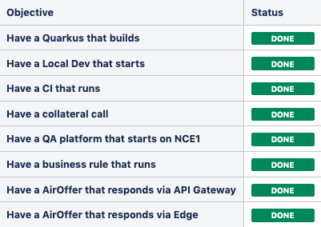
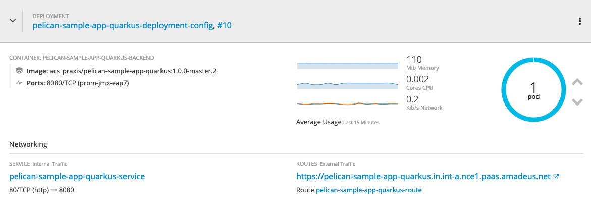
Supersonic Subatomic Pelican
Team | Sanka SAMARANAYAKE / Matteo CASALINO / Fabrice PIPART
Problem | Pelican aims at revisiting the development experience and the operability of our Java backends in the Cloud. But it is based on an application server that takes minutes to start and eat tons of RAM.
Idea | Prototype the usage of Quarkus to accelerate all phases of the lifecycle of Pelican. From Dev to Prod. Quarkus is lighweight, Cloud native, starts in a few seconds, consumes a minimal amount of RAM and is designed for developer joy.
Delivery
…

Slide 24

Improve Interaction Speed
Notes:
Move redux logic into Javascript Workers

Slide 25
Improve Interaction Speed
The team
Stefan SEEGER mentored by Guilherme VIEIRA SCHWADE
The problem
All Javascript applications are running the code in the one main thread. This means that big data computations are blocking UI interactions.
The idea
Move the store logic into WebWorkers to parallelize them
Delivery
PoC on RefX Availability to assess the time to interaction gains
Risks
Sharing data across WebWorkers creates overhead – It is going to be exciting!

Slide 26
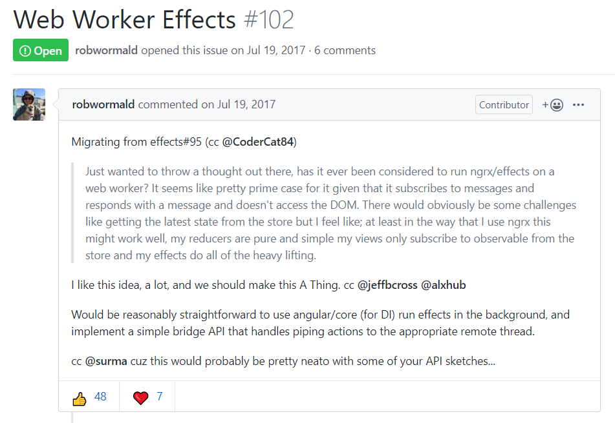
Improve Interaction Speed
https://github.com/ngrx/platform/issues/102
https://github.com/ngrx/platform/issues/102

Slide 27
Let’s go for speed! Demo Friday the 13th

Slide 28

Notes:
In 10 min, list as many ideas as possible to make these AT-ATs quicker.

Slide 29
Some rules
Be positive & constructive Comment to build on ideas, not highlighting flaws Use “Yes and” instead of “No, but…”!
It’s too early to assess technical difficulty Don’t block yourself thinking about ideas you find too hard to implement
Let people speak, one discussion at a time
There is no silly idea! Say whatever goes through your mind

Slide 30
Problems Finding

Slide 31

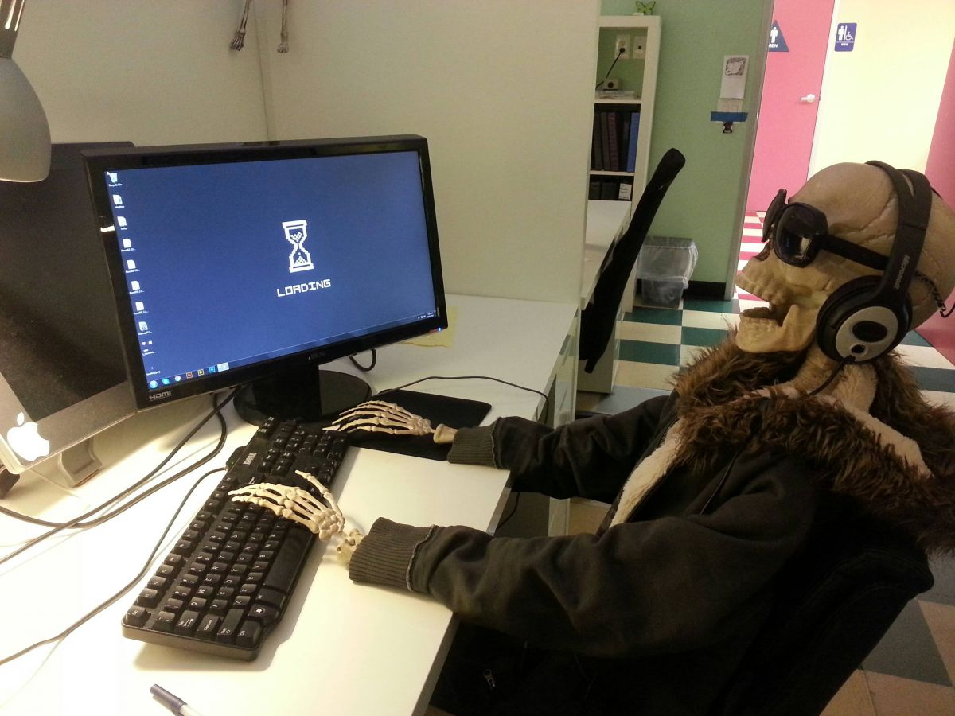
15’
List :
Problems you faced as a user in slow or too complex interfaces
Problems of slowness you know we have in our interfaces

Slide 32

Notes:
Think about elderly, disabled people.
What does it mean for them to make the applications/interfaces quicker?

Slide 33

Notes:
Think about industries where response time is key. How did they manage to reach their objectives? Anything we could re-use?

Slide 34

Notes:
What would mean having quicker interfaces for this user? How would we help him achieve his goal?

Slide 35
Problems Consolidation
30’

Slide 36
Problems Selection
10’

Slide 37
Wrap-up and next steps

